Slide 1
Differential Information and Performance Measurement Using a Security Market Line
Authored by Philip H. Dybvig and Stephen A. Ross
Presented by: Sprinkle Zhang

Slide 2
Agenda
Introduction
Main Contents:
I. What Can Go Wrong
II. Mean-Variance Analysis and Informed Portfolio Choice
III. What Can Go Right: A Positive Theorem on the Use of the SML
IV. An Example without any Riskless Asset
V. Summary and Conclusions
My Opinions
Notes:
In section I, we present a plausible example that illustrates what can go wrong with the use of SML analysis in the presence of market timing.
Section II sets up the general theory of superior performance under differential information in mean-variance model.
Section III presents the positive result that significantly generalized the Mayes and Rice “asset-specific” result.
Section IV presents an example that shows what can go wrong with SML Analysis when there is no riskless asset
Section V discusses directions for future research.

Slide 3
Introduction
An uninformed observer using the tools of mean variance and security market line analysis to measure the performance of a portfolio manager who has superior information is unlikely to be able to make any reliable inferences. While some positive results of very limited nature are possible, e.g., when there is a riskless asset or when information is restricted to be “security specific”.
In particular, a manager with superior information can appear to the observer to be below or above the security market line and inside or outside of the mean-variance efficient frontier, and any combination of these is possible.

Slide 4
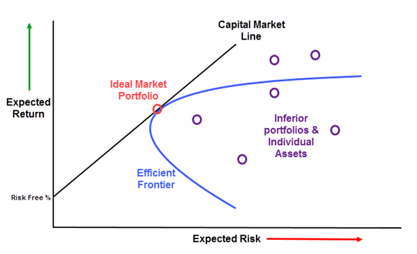
Mean-Variance Theory predicts that if we plot expected returns against beta coefficients, all securities plot on a single line, know as Security Market Line (SML). The market line is a graphical representation of the linear relationship between expected return and risk.
What are we to make of deviations from the SML, i.e., of securities or managed portfolios that do not plot on such a line? *The intuitive explanation of deviations has motivated many calls to measure the performance of portfolio managers. In this paper, we mainly analyze SML deviations caused by superior performance based on superior information.
Notes:
*If we can retain our intuitive interpretation of beta as the riskiness of asset and the market line as the appropriate expected return needed to ”reward” agents taking on various degrees of risk, the vertical deviations from the market line represent abnormal returns.

Slide 5
Roll’s Model:
He pointed out that the mean-variance theory is not theoretically correct. Roll called for an alternative model to explain deviations from the SML. In Roll’s model, the market portfolio is misspecified, the index used as a proxy for the market portfolio is inefficient. Superior performance is ruled out. He thought SML analysis is never justified.
Mayers and Rice:
SML analysis is generally valid when superior performance is caused by superior information. Their conclusion based on two results:
SML analysis correctly measures the performance of agents whose information is “security specific”
The analysis is being valid more generally.
In fact, the second result is not very general, since it is based on assumptions that in effect assume again that information is “security specific”.
“security specific”: the superior performers with security-specific information will plot above the SML. It tells us something about the returns to specific securities but nothing about the market as a whole.*
Notes:
The most important recent critique of these arguments was mounted by Roll in his series of papers criticizing existing applications and tests of the CAPM. He pointed out that the mean-variance theory is not theoretically correct. He thought that the interpretation of beta as a measure of riskiness is based on the validity of mean-variance theory. However, if mean-variance theory were valid, there would be no abnormal returns, since all securities would plot on the SML.
* A pure example of security-specific information might be knowledge of which of two firms will win a lawsuit or whether an acquisition will take place. Operationally, almost any “stock tip” about a single firm should be thought of as security specific, since knowing something good or bad about a single firm does not give us any useful information about the market as a whole.

Slide 6
Our Results:
We extend and validate the Mayers and Rice result by removing all but a few simple assumptions, and we explore its scope and limitations. Contrary to Mayers and Rice, we find that differential information disrupts the validity of SML analysis, since it takes us outside the domain of mean-variance analysis. *
Mean-variance Analysis can fail. Even if underlying asset returns and the manager’s signal are joint normally distributed, the portfolio return includes the product of the asset returns and the portfolio manager’s strategy, which is a function of his information. The product might be skewed to the right, in which case the portfolio would be more attractive to an investor than a normally distributed return with the same mean and variance. Another concern is that, a successful market timer will be more highly invested in the market, on average, when the market is up, and that is a changing beta over time might invalidate SML analysis.
Notes:
*Our final conclusion is more temperate than Roll’s assertion that SML is never justified, while still far from the Mayers and Rice assertion that it is always justified.

Slide 7
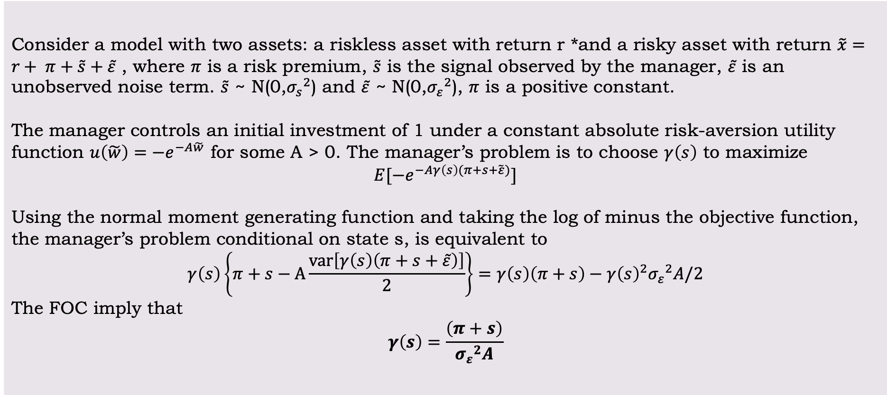
I. What Can Go Wrong
Consider a model with two assets: a riskless asset with return r *and a risky asset with return $\tilde{x}=r+ π+\tilde{s}+\tilde{ε}$ , where $π$ is a risk premium, $\tilde{s}$ is the signal observed by the manager, $\tilde{ε}$ is an unobserved noise term. $\tilde{s}$ ~ N(0,${σ_{s}}^{2}$) and $\tilde{ε}$ ~ N(0,${σ_{ε}}^{2}$), $π$ is a positive constant.
The manager controls an initial investment of 1 under a constant absolute risk-aversion utility function $u\left(\tilde{w}\right)=−e^{−A\tilde{w}}$ for some A > 0. The manager’s problem is to choose $γ\left(s\right)$ to maximize
$$E[−e^{−Aγ\left(s\right)(π+s+\tilde{ε})}]$$
Using the normal moment generating function and taking the log of minus the objective function, the manager’s problem conditional on state s, is equivalent to
$$γ\left(s\right)\left\{π+s−A\frac{var\left[γ\left(s\right)\left(π+s+\tilde{ε}\right)\right]}{2}\right\}=γ\left(s\right)\left(π+s\right)−{γ\left(s\right)}^{2}{σ_{ε}}^{2}A/2$$
The FOC imply that
$$γ\left(s\right)=\frac{\left(π+s\right)}{{σ_{ε}}^{2}A}$$
The manager’s portfolio choice
Notes:
This section is devoted to a simple “market timing” example that calls into serious doubt the use of abnormal returns analysis to measure performance.
* (here we assume r = 0 since it does not affect the conclusion)

Slide 8
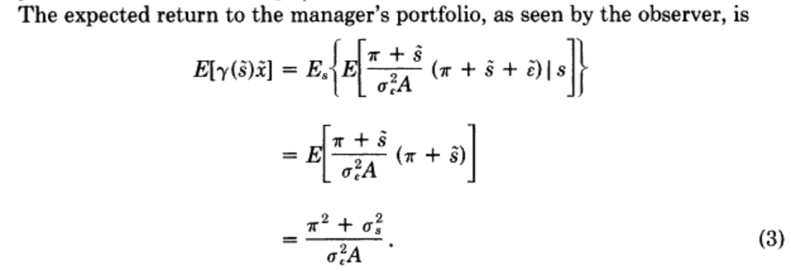

The unconditional abnormal return $δ_{γ}$ to a portfolio $γ\left(s\right)$ are defined by
$δ_{γ}=E\left[γ\left(\tilde{s}\right)\tilde{x}\right]−r−β_{γ}\{E\left[α\left(\tilde{s}\right)\tilde{x}\right]−r\}$
where
$$β_{γ}=cov\left[α\left(\tilde{s}\right)\tilde{x},γ\left(\tilde{s}\right)\tilde{x}\right]/var[α\left(\tilde{s}\right)\tilde{x}]$$
The portfolio $α\left(\tilde{s}\right)$ is assumed to be known to the observer and does not depend on s. Therefore, we write $α$ instead of $α\left(\tilde{s}\right).$ Then we have
The expected return to manager’s portfolio
CAPM: The expected return on SML
Law of iterated expectations
E[A] = E[E[A|B]]
Notes:
$α\left(\tilde{s}\right)$ is market index or benchmark portfolio

Slide 9
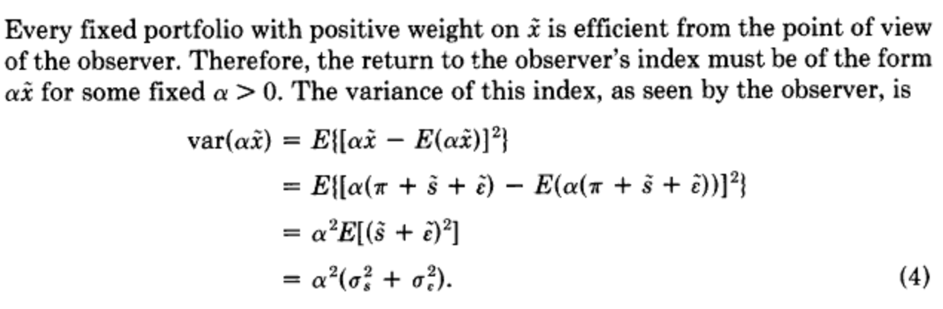
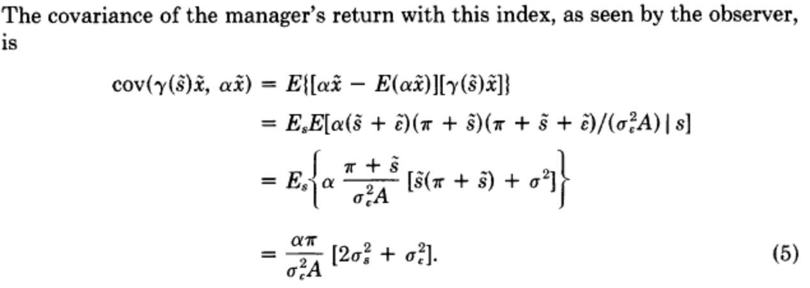
Calculating Beta
Notes:
Cov(A,B) = E[AB] – E[A]E[B]
Law of iterated expectations E[A] = E[E[A|B]]

Slide 10
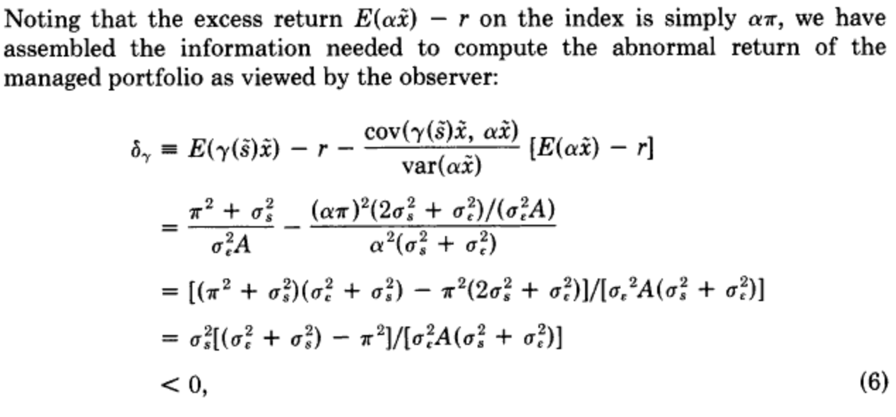
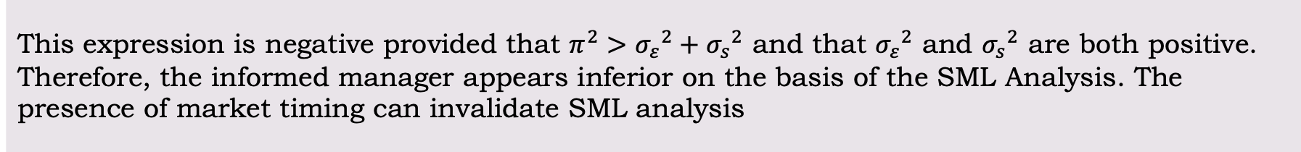
This expression is negative provided that $π^{2}>{σ_{ε}}^{2}+{σ_{s}}^{2}$ and that ${σ_{ε}}^{2}$ and ${σ_{s}}^{2}$ are both positive. Therefore, the informed manager appears inferior on the basis of the SML Analysis. The presence of market timing can invalidate SML analysis
Notes:
**Important result

Slide 11
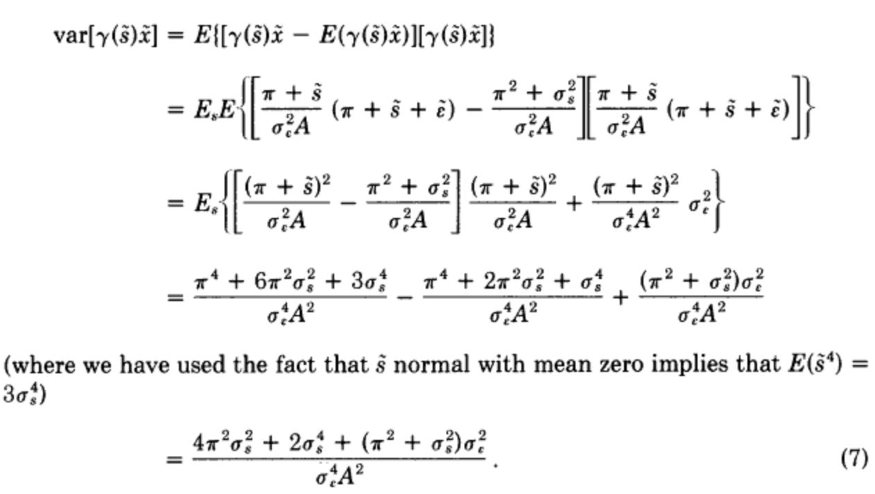
Surprisingly, the manager’s portfolio appears inferior in mean and variance as well. The observed variance of the manager’s portfolio is:
Notes:
Var[Y] = E[Y^2] – (E[Y])^2 = E[(Y-E(Y))Y]
Law of iterated expectations E[A] = E[E[A|B]]

Slide 12
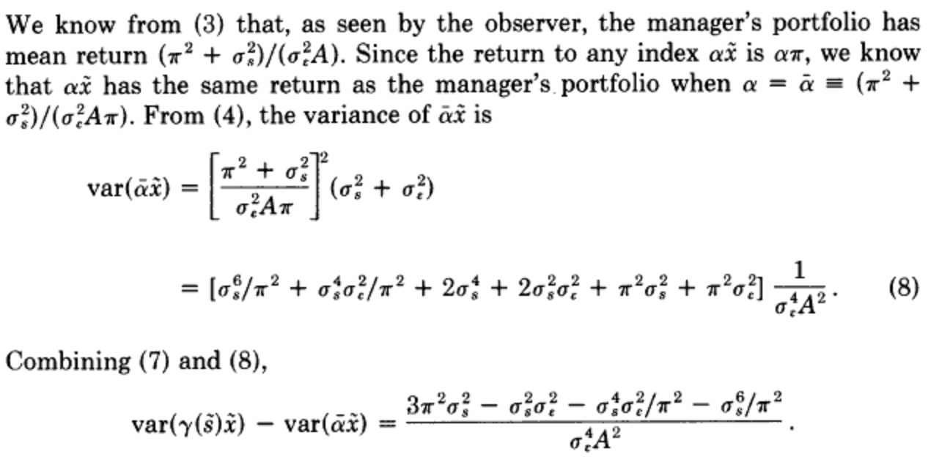
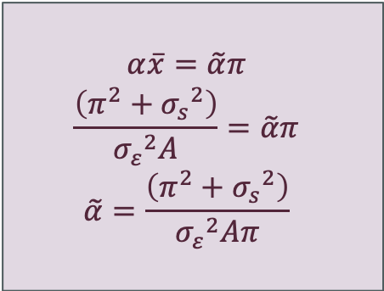
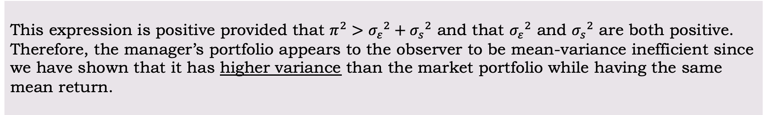
$$α\overline{x}=\tilde{α}π$$
$$\frac{\left(π^{2}+{σ_{s}}^{2}\right)}{{σ_{ε}}^{2}A}=\tilde{α}π$$
$$\tilde{α}=\frac{\left(π^{2}+{σ_{s}}^{2}\right)}{{σ_{ε}}^{2}Aπ}$$
This expression is positive provided that $π^{2}>{σ_{ε}}^{2}+{σ_{s}}^{2}$ and that ${σ_{ε}}^{2}$ and ${σ_{s}}^{2}$ are both positive. Therefore, the manager’s portfolio appears to the observer to be mean-variance inefficient since we have shown that it has higher variance than the market portfolio while having the same mean return.

Slide 13

To understand why this paradoxical result obtains even though both agents view returns as normal, and therefore have utility functions over mean and variance. Let us reexamine the returns to the manager’s portfolio:
*
How is it that the manager’s portfolio has a non-normal distribution even though the manager and the observer both face normal conditional returns?
The answer is that the manager faces returns that are normal conditional on s, but that the product of his portfolio choice as a function of s and the return as a function of s is no longer normally distributed, therefore, is outside the domain on which manager’s utility depends on only on the mean and variance of returns.**
Notes:
* The first term in the numerator is constant and the next two terms are normally distributed. The term s^2, however, has a chi-squared distribution. Since this term is skewed to the right and bounded below, the manager views this part of the return more favorably than the manager would view a normal random variable with the same mean and variance.
** Note, lastly, that by reversing the assumption of our example, and setting $π^{2}<{σ_{ε}}^{2}+{σ_{s}}^{2}$, we will have positive abnormal return instead and the manager will plot above the observer’s SML.

Slide 14
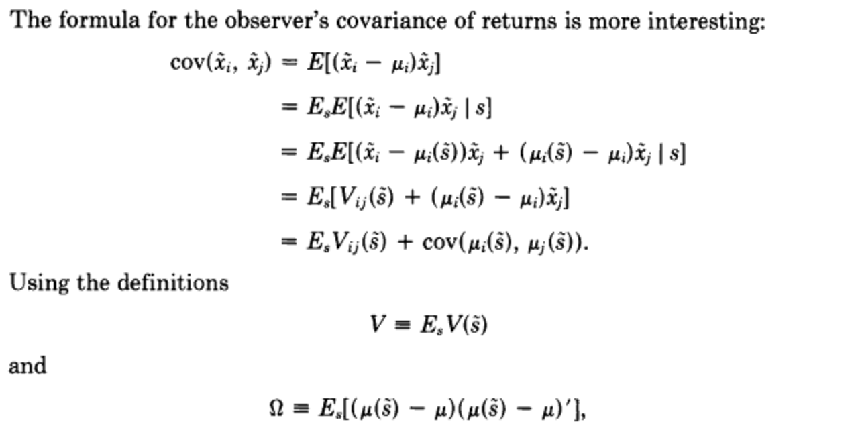
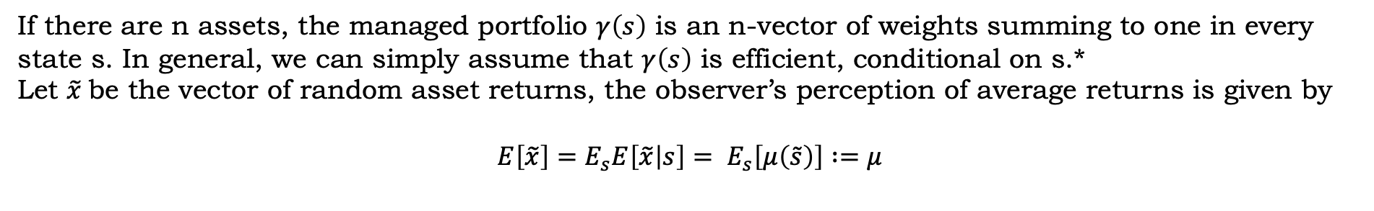
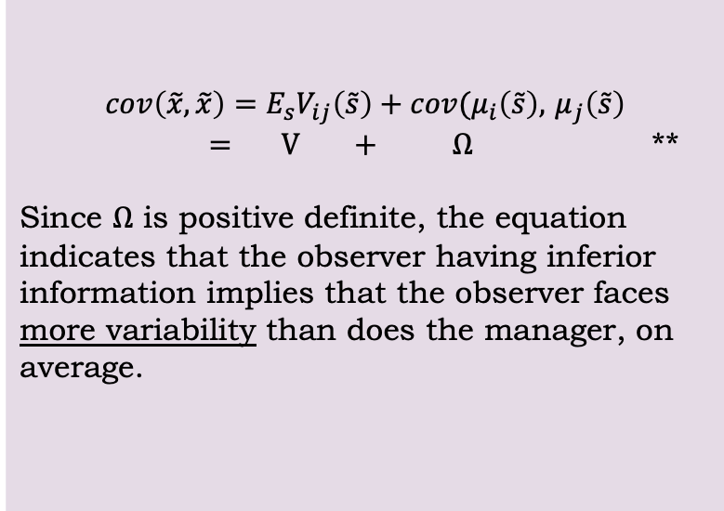
II. Mean-Variance Analysis and Informed Portfolio Choice
If there are n assets, the managed portfolio $γ\left(s\right)$ is an n-vector of weights summing to one in every state s. In general, we can simply assume that $γ\left(s\right)$ is efficient, conditional on s.*
Let $\tilde{x}$be the vector of random asset returns, the observer’s perception of average returns is given by
$$E\left[\tilde{x}\right]=E_{s}E\left[\tilde{x} | s\right]= E_{s}\left[μ\left(\tilde{s}\right)\right] :=μ$$
$cov\left(\tilde{x},\tilde{x}\right)=E_{s}V_{ij}\left(\tilde{s}\right)+cov(μ_{i}\left(\tilde{s}\right),$ $μ_{j}\left(\tilde{s}\right)$
$= V + Ω$ **
Since $Ω$ is positive definite, the equation indicates that the observer having inferior information implies that the observer faces more variability than does the manager, on average.
Notes:
Next we explore under what circumstances SML analysis can be trusted. As in the example, we assume that an uninformed observer is monitoring the performance of another agent, the manager, who uses superior information in the form of an observation of an information state s, to select a portfolio.
* Note that we are assuming away the agency problem in this context
**Variance-Covariance matrix seen by observer = the average variability seen by the manager + the shift in the manager’s mean across states.

Slide 15
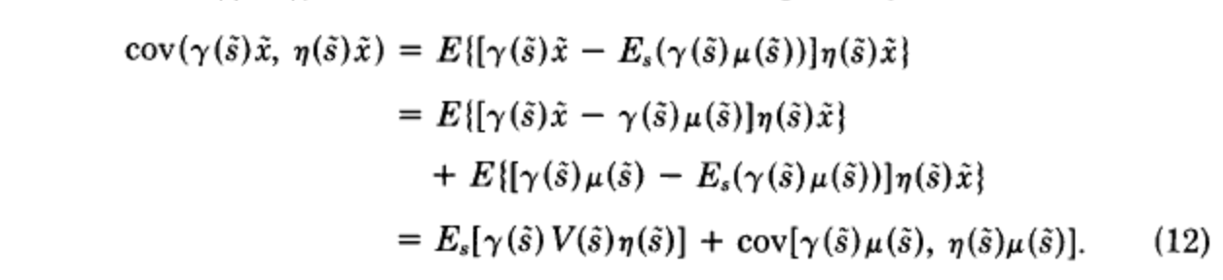
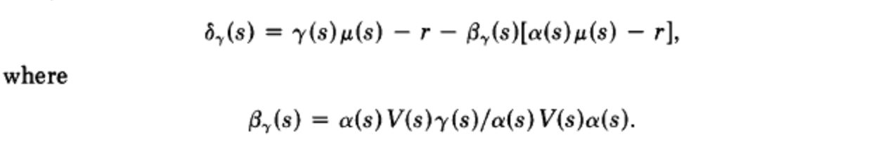
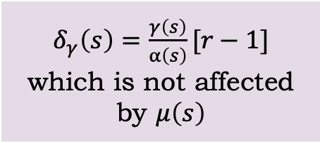
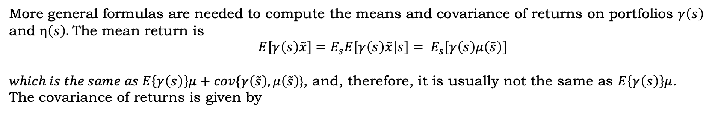
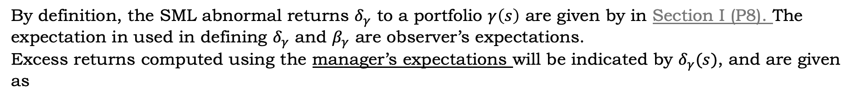
More general formulas are needed to compute the means and covariance of returns on portfolios $γ\left(s\right)$ and $η\left(s\right).$The mean return is
$E\left[γ\left(s\right)\tilde{x}\right]=E_{s}E\left[γ\left(s\right)\tilde{x} | s\right]= E_{s}\left[γ\left(s\right)μ\left(\tilde{s}\right)\right]$
$which is the same as E\left\{γ\left(s\right)\right\}μ+cov\{γ\left(\tilde{s}\right),μ\left(\tilde{s}\right)$}, and, therefore, it is usually not the same as $E\left\{γ\left(s\right)\right\}μ$.
The covariance of returns is given by
By definition, the SML abnormal returns $δ_{γ}$ to a portfolio $γ\left(s\right)$ are given by in Section I (P8). The expectation in used in defining $δ_{γ}$ and $β_{γ}$ are observer’s expectations.
Excess returns computed using the manager’s expectations will be indicated by $δ_{γ}(s)$, and are given as
$δ_{γ}\left(s\right)=\frac{γ\left(s\right)}{α\left(s\right)}[r−1]$ which is not affected by $μ\left(s\right)$

Slide 16
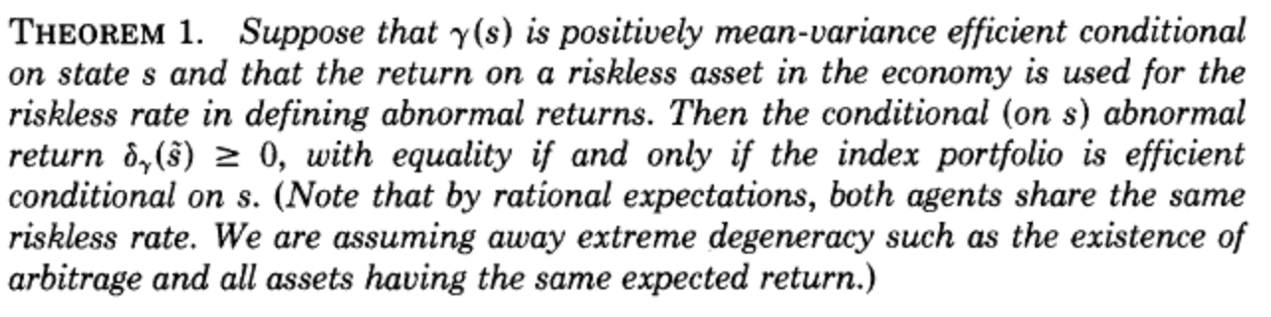
Some conclusions for this section
The result shows that if we could measure performance conditional on the manager’s information, superior performance would register correctly in SML excess returns.
Intuitively, it means that the source of difficulty in using abnormal returns analysis is that the observer cannot look at things from the perspective of the informed manager.

Slide 17
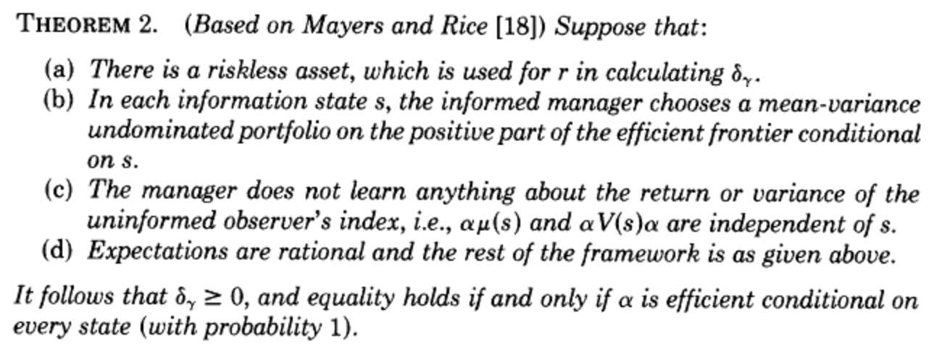
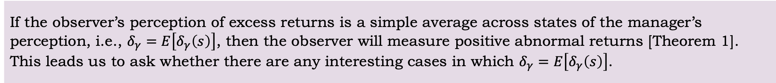
III. What Can Go Right: A Positive Theorem on the Use of the SML
If the observer’s perception of excess returns is a simple average across states of the manager’s perception, i.e., $δ_{γ}=E\left[δ_{γ}\left(s\right)\right]$, then the observer will measure positive abnormal returns [Theorem 1]. This leads us to ask whether there are any interesting cases in which $δ_{γ}=E\left[δ_{γ}\left(s\right)\right]$.

Slide 18
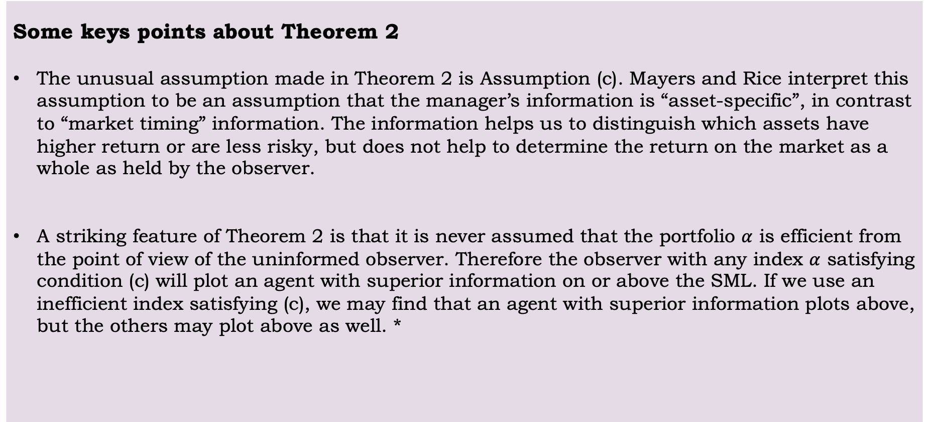
Some keys points about Theorem 2
The unusual assumption made in Theorem 2 is Assumption (c). Mayers and Rice interpret this assumption to be an assumption that the manager’s information is “asset-specific”, in contrast to “market timing” information. The information helps us to distinguish which assets have higher return or are less risky, but does not help to determine the return on the market as a whole as held by the observer.
A striking feature of Theorem 2 is that it is never assumed that the portfolio $α$ is efficient from the point of view of the uninformed observer. Therefore the observer with any index $α$ satisfying condition (c) will plot an agent with superior information on or above the SML. If we use an inefficient index satisfying (c), we may find that an agent with superior information plots above, but the others may plot above as well. *
Notes:
* which is simply to say that the power of the test in rejecting superior performance is less when the index is inefficient

Slide 19
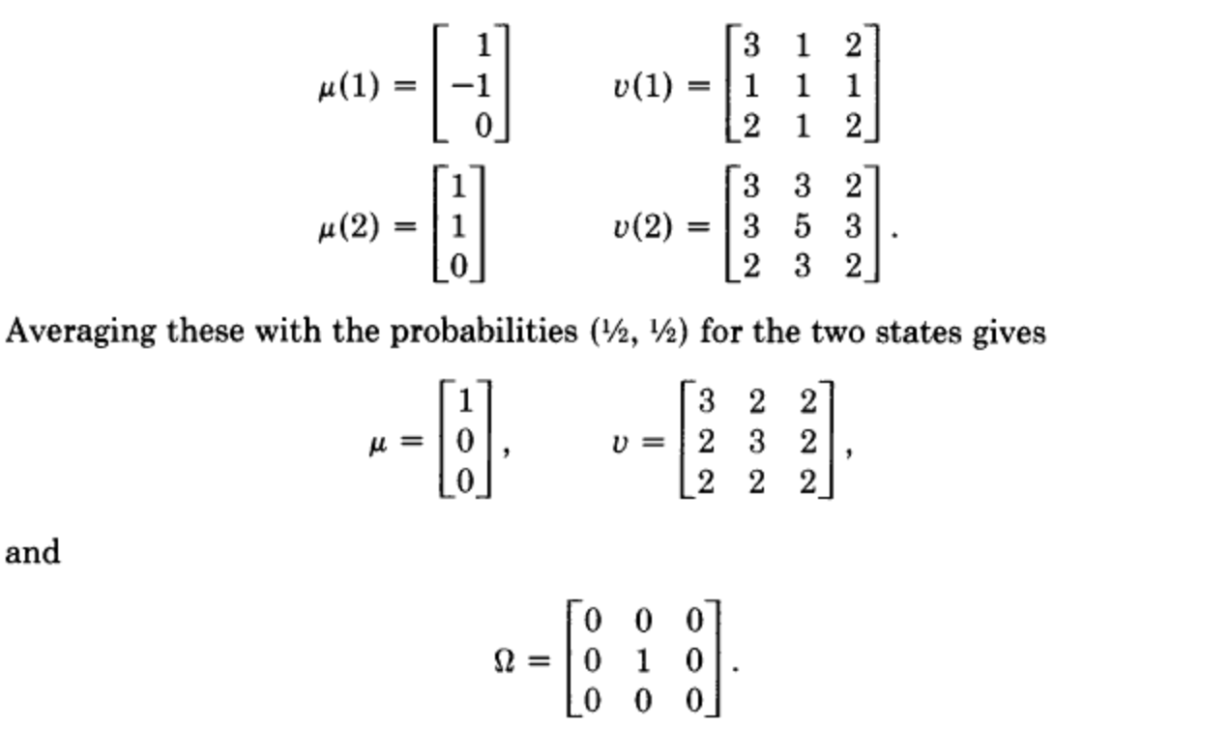
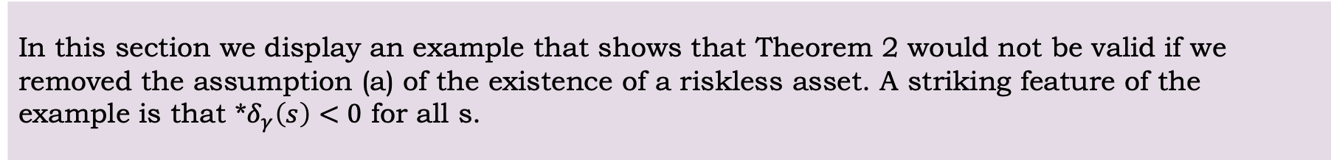
IV. An Example without any Riskless Asset
In this section we display an example that shows that Theorem 2 would not be valid if we removed the assumption (a) of the existence of a riskless asset. A striking feature of the example is that *$δ_{γ}\left(s\right)<0$ for all s.
Suppose we have three assets and two equally probable information states. The return vectors and covariance matrices in the two states are given by
Notes:
* Excess returns computed using the manager’s expectations

Slide 20
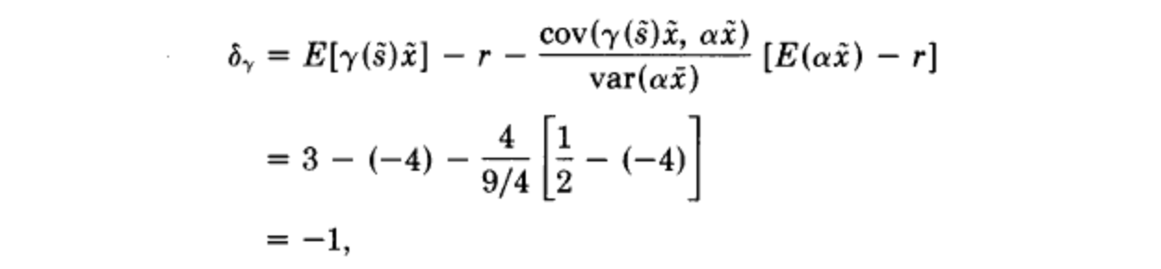
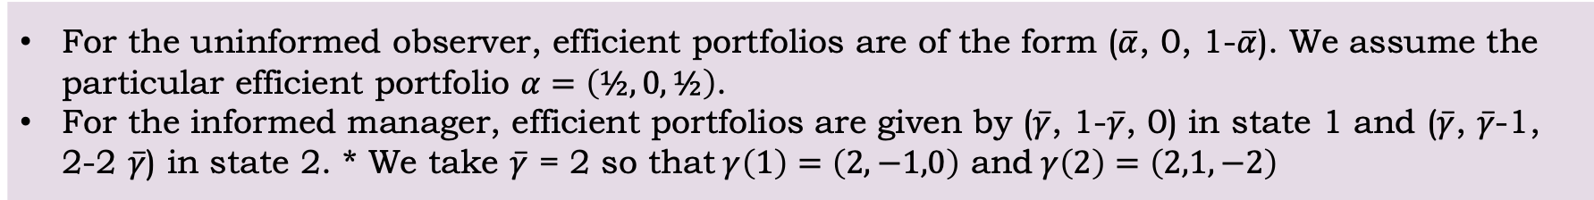
For the uninformed observer, efficient portfolios are of the form ($\overline{α}$, 0, 1-$\overline{α}$). We assume the particular efficient portfolio $α=\left(½, 0,½\right)$.
For the informed manager, efficient portfolios are given by ($\overline{γ}$, 1-$\overline{γ}$, 0) in state 1 and ($\overline{γ}$, $\overline{γ}$-1, 2-2 $\overline{γ}$) in state 2. * We take $\overline{γ}$ = 2 so that$γ\left(1\right)=\left(2,−1,0\right)$ and$γ\left(2\right)=\left(2,1,−2\right)$
The zero-beta rate** for the uninformed observer is the rate implicit in the observer’s choice of efficient portfolio, which can be calculated to be -4. By the definition of abnormal return, we have
This shows a superior performer can plot below even when information is “security specific”, provided there is no riskless asset.
Together with the example of Section I, this completes the taxonomy of cases: an informed agent can plot above or below the SML, and independently can be mean–variance efficient or dominated.
Notes:
*We have designed the covariances and returns so that returns in state 2 are just the returns in state 1 reflected across the uninformed observer’s efficient set {($\overline{α}$, 0, 1-$\overline{α}$)}.
**The zero-beta rate means the expected return of the portfolio is equal to the risk-free rate, and the covariance of the three assets is 0.

Slide 21
V. Summary and Conclusions
The paper has shown the fragile nature of SML Analysis for the evaluation of performance. A manager who makes optimal use of superior information may plot above, on, or below the SML.
If the reference portfolio is known to be efficient, a manager plotting above the SML necessarily has differential information, but we cannot tell whether or not that information is being used correctly; On the other hand, if the observer has chosen an inefficient portfolio (misspecified index), then the abnormal returns may simply reflect the inefficiency and not superior information.
We require a new performance measurement technique. First, it should correctly identify superior, ordinary and inferior performance. Second, it should work correctly even when the manager being evaluated understands the measure being used. Finally, the manager should be sufficiently powerful to be useful in practice.*
Notes:
* For instance, a measure requiring 20 years of data to get an accurate measurement will not be useful in yearly decisions of whether to retain a manager.
The last requirement is likely to be the ultimate stumbling block, since the large amounts of noise in common stock returns seem to make it impossible to measure significant superior or inferior performance over time periods.

Slide 22
My Opinions
Well-structured paper
Rigorous Examples and Theorems
Agree with the author’s opinion and will explore further about the solution to the new measurement technique
Notes:
The paper has shown the fragile nature of SML Analysis for the evaluation of performance. A manager who makes optimal use of superior information may plot above, on, or below the SML.

Slide 23
Questions?

